Slide 1


Introduction to Python – Week 4
Mark Smith

Slide 2
Course outline
Lesson 1 – Getting Started: Introduction and Arithmetic Operators
Lesson 2 – Types and Variables
Lesson 3 – Functions
Lesson 4 – Conditional Statements
Lesson 5 – Iteration
Lesson 6 – Strings
Lesson 7 – Lists
Lesson 8 – Dictionaries
Lesson 9 – Tuples
Lesson 10 – Project

Slide 3
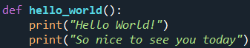
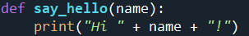
Last Week
What are functions?
How do we define functions?
How can we use functions in our programs?

Slide 4
This Week – Conditional statements
Today we will learn:
What are Relational Operators
What are Logical Operators
How do we use Conditional statements

Slide 5
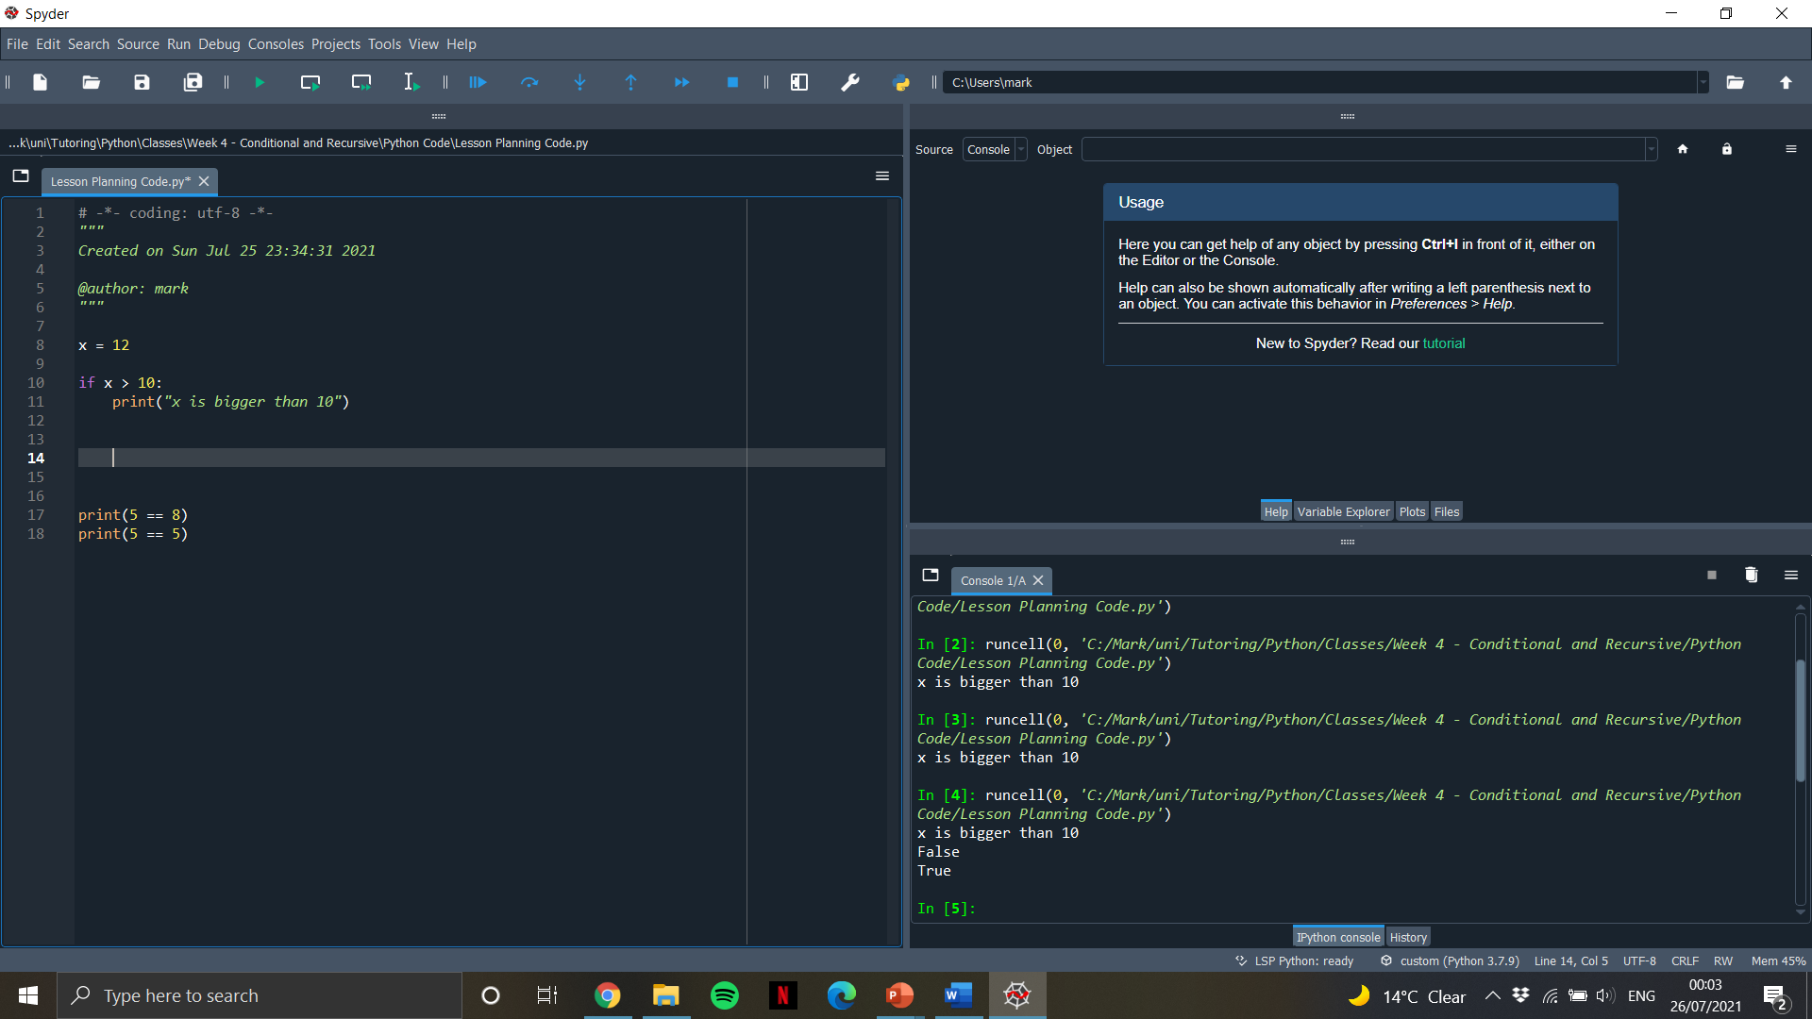
Boolean expressions
A Boolean Expression is one that is either true or false. We can use the == operator to check for equality.

Slide 6
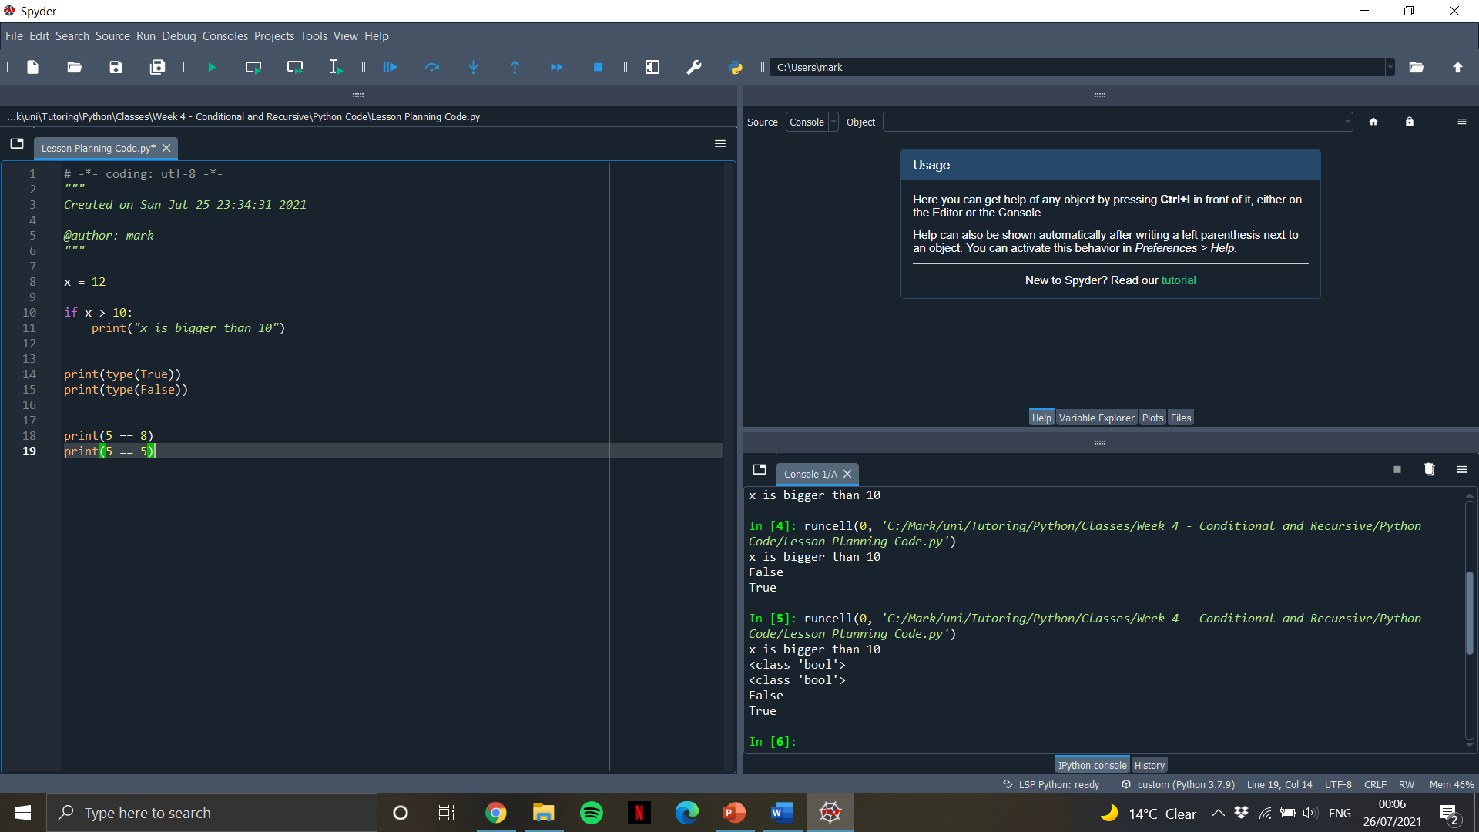

Boolean variables
True and False are special values that belong to the type ‘bool’, they are not strings.
Notes:
Go To Exercises 1 for the week

Slide 7
Relational operators
Here are all the relational operators
Code | Statement (True if…) | True | False
x == y | X is equal to y | 5 == 5 | 5 == 3
x != y | X is not equal to y | 5 != 4 | 4 != 4
x > y | X is greater than y | 5 > 3 | 3 > 5
x < y | X is less than y | 3 < 5 | 5 < 3
x >= y | X is greater than or equal to y | 4 >= 4 | 4 >= 2
x <= y | X is less than or equal to y | 4 <= 10 | 10 <= 4

Slide 8

Relational operators - Practise
Question | Statement | True(T) or False(F)?
1. | 4 > 6 | F
2. | ‘hi’ != ‘h’
3. | 3 < 1
4. | 3 <= 3
5. | 9 >= 4
6. | 4 < 10
7. | 1 > 5
8. | ‘j’ == ‘j’
9. | 8 != 9
10. | 6 > 8
Notes:
Go to exercises 2 in week

Slide 9
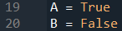
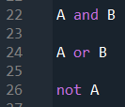
Logical operators
Alongside relational operators, we have logical operators that allow us to join Boolean expressions together
False
True
False

Slide 10
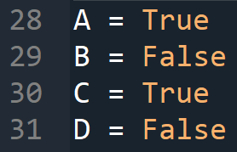
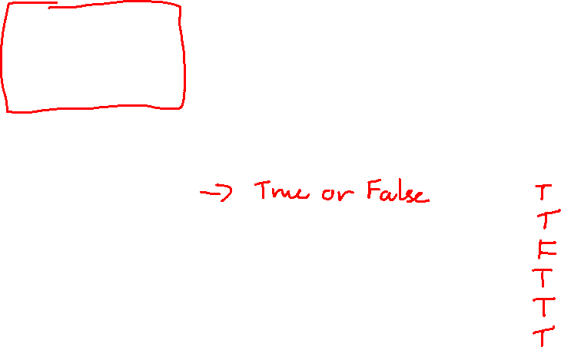
LOGICAL operators - Practise
Question | Statement | True(T) or False(F)?
1. | A and B | F
2. | A or B
3. | not D
4. | B or D
5. | A and C
6. | B or C
7. | not B

Slide 11
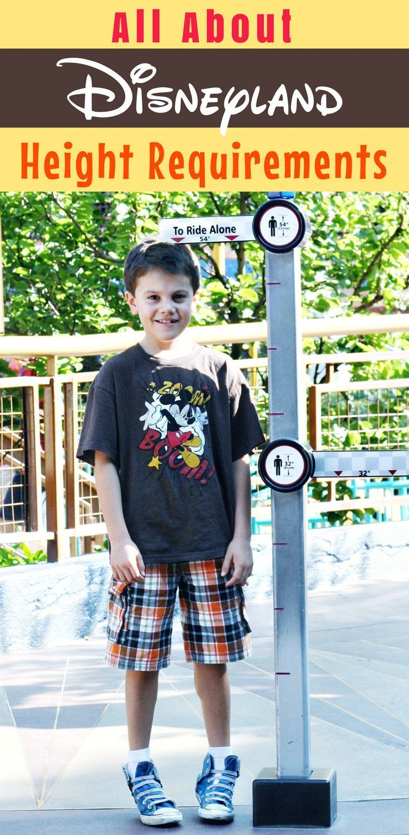
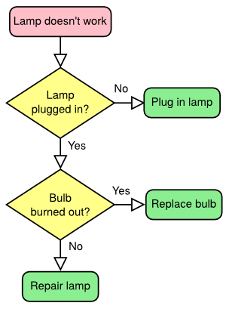

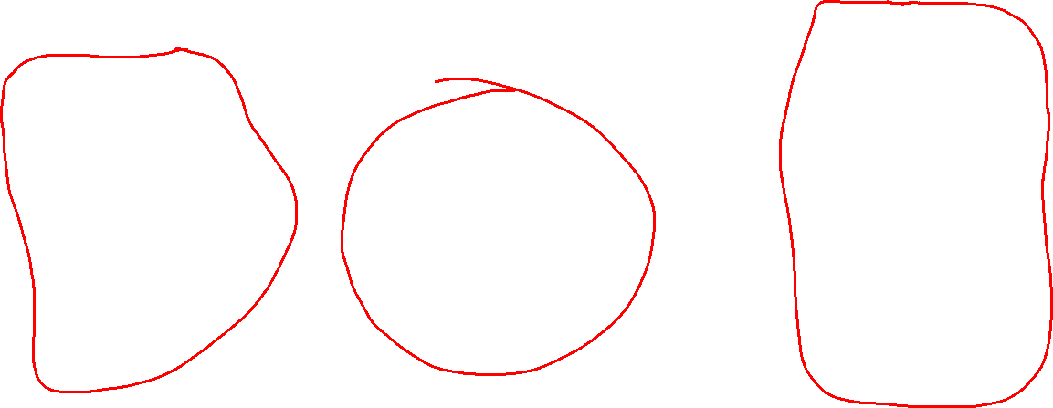
What is a conditional statement?
A conditional statement in Python is one that checks a condition before deciding whether or not to run a piece of code.

Slide 12
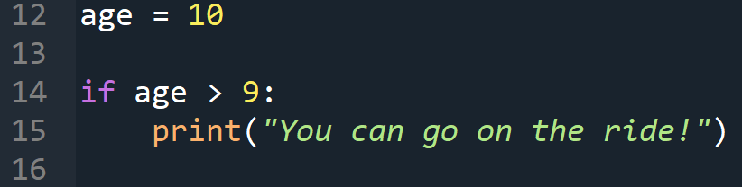
Writing conditional statements
Now, we can define conditional statements as follows,
The way we define a conditional statement looks very similar to the way we defined something else… What is that?
Notes:
Go to Exercises 3 in week

Slide 13
End of class
This week we have looked at:
What are Relational Operators
What are Conditional Operators
How do we use Conditional statements

